Slide 1
Automation/ Development of Computer
Ganesh Kumar Ranjan
Faculty,MJMC,
MMHA&PU

Slide 2
Advance technology of warfare influences in shaping of modern computer function and application.
Military establishment across world required a better command and control system especially in time of war. They have always in fear of getting destroyed their command and control centre so they wanted a decentralised command and control so that if one node get destroyed they can work with others.

Slide 3
Despite military influences it has been a long civil and commercial set of interests that work in creation of machine that could repeat human actions, functions and task that today we see as computer.
The more recent historical context of such machines was the European Industrial Revolution

Slide 4
Late 18th century
Farm & cottage Industry
(By Hand)
Industrial Mills
Increased application of Machines
Textile Industry
Mechanical Looms & Weaving machines
Cloths
More cheaply produced in large quantities

Slide 5
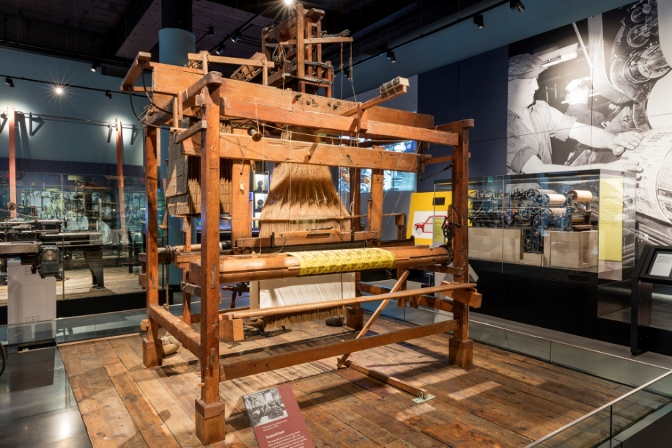
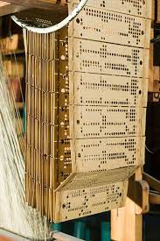
Jacquard loom is an early example of the introduction of automation of weaving.
Here sophisticated patterns could be produced by ‘programming’ the loom using a sting of cards with punched holes.

Slide 6
After 150 years of Jacquard Loom
Analogue Computers used linear punched- cards to create programmes for processing Data
Replaced by
Later Punched- tape
Magnetic Tape
Ex: The Abascus Frame
Slide Rule

Slide 7
Charles Babbage(1791-1871)
Difference Engine
Consisting of logs, levers and springs was a dedicated device intended for calculation and production of mathematical tables for use in nautical navigation.
Early 20th century- Development of electricity
1950’s Valves were replaced by solid state Diode Technology & magnetic tape used to store programming information
Computer
Use large space
Ex- SEAE( Standard Eastern Automatic Computer)

